Slide 1
Morphological Groups of soil bacteria

Slide 2
Difficult to group soil bacteria -
Due to vast variety and number of bacteria present, it has not been possible to describe all types or to determine the generic placement of all strains.
Difficult to characterize soil bacteria on morphological basis -
Because many of the dominant soil strain exhibit several shapes in culture depending on cell age and medium used.
e.g. :- a common bacterium is a gram negative rod when young………….. Becomes gram positive coccoid as the culture ages.

Slide 3
By performing gram staining of isolated colonies on plate the following bacteria seems to be prominent :-
Non-spore forming rods of various sizes
Spore-forming bacilli
Cocci
Short rods changing into cocci
Many soil bacteria are pleomorphic….changing shape during growth
Short rods changing to cocci…..mainly Arthrobacter
Spore-forming rods …..Bacillus

Slide 4
Morphological Categories of Microorganisms in two New Zealand Soils (By Gram staining method)
Category of Microorganisms | Percent of Total isolates
 | Hastings soil | Napier soil
Rods, non-spore forming
Gram + | 19-24 | 17-29
Gram - | 2-6 | 3-7
Rods spore-forming | 12-18 | 10-15
Pleomorphic bacteria | 36-46 | 31-41
Actinomycetes | 11-25 | 12-32

Slide 5
In-situ soil bacterial shapes are quite often different when grown in culture media.
A high % of soil bacteria are surprisingly small, many with diameters less than 0.3 μm and some smaller that 0.1 μm
So, a significant proportion of cells cannot be viewed by light microscopy.
Electron microscopy shows different morphology than when grown in culture media and gram staining.
For example: some bear stalks
Some have surface appendages
Some are star shaped
Some show minute bulges on the surface

Slide 6
Stella, a group of flat, six-pronged star-shaped prosthecobacteria found in freshwater, soil, and sewage in widely separated geographical areas.
The morphology of the cells provides clear differentiation from all other eubacteria. The cellular morphology and mode of multiplication of these organisms also provide clear separation from other budding and appendaged prosthecobacteria.
The cells are gram negative, flat, nonmotile, and asporogenic. Representative organisms in the genus are chemoorganotrophic, growing on low nutrient concentrations and utilizing a variety of amino acids and organic acids.

Slide 7
Stella humosa (type species) is an avacuolate organism,
Stella vacuolata is a gas vacuolate prosthecobacterium.
Organisms in the genus Stella appear to represent the first example of radial symmetry in procaryotic cells.

Slide 8
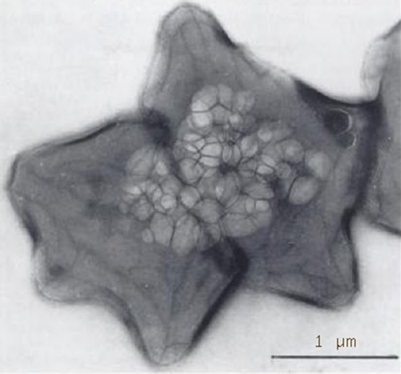
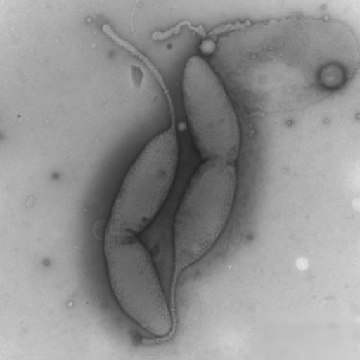
The left one is Stella vacuolata. Those bubbles in the middle are gas.
Left: Caulobacter rhizosphaerae: Gram-reaction-negative, aerobic, white- to pale-yellow-coloured and rod-shaped bacterium with a single polar flagellum or a stalk, designated strain 7F14T, was isolated from rhizosphere soil of cultivated watermelon field.

Slide 9
prosthecae (Greek for appendage), and can serve many functions:
They can increase surface area without increasing mass for better diffusion.
They can make a bacterium large enough to not be eaten.
They may also catch more water, to help non-motile bacteria be moved along by the current.

Slide 10
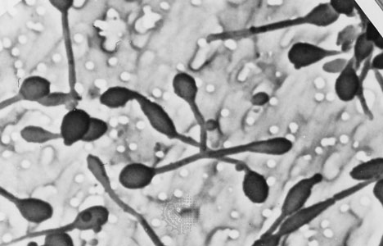
In the budding bacteria Hyphomonas polymorpha, the bud grows out of the end of a filament called a prostheca.

Slide 11
Taxonomic Groups of bacteria commonly found in soil or of particular interest:-
Acinetobacter
Agrobacterium
Caulobacter
Cellulomonas
Clostridium
Corynebacterium
Flavobacterium
Hyphomicrobium
Metallogenium
Micrococcus
Mycobacterium
Pedomicrobium
Pseudomonas
Sarcina
Staphylococcus
Streptococcus
Xanthomonas

Slide 12
Comparative number of soil bacteria encountered by plating method:-
Bacillus 7-67 %
Arthrobacter 5-60 %
Pseudomonas 3-15 %
Agrobacterium up to 20 %
Alcaligenes 2-12 %
Flavobacterium 2-10 %
Corynebacterium, Micrococcus, Staphylococcus, Xanthomonas, Mycobacterium, Sarcina altogother less than 5 %

